Slide 1





AIRPLANE CRASH ANALYSIS WITH POWER BI
K.SANDHYA

Slide 2


Power BI is like a super-smart tool that helps businesses understand their data better. It takes information from different places like spreadsheets, databases, or websites, and turns it into colorful charts and graphs that are easy to understand. So, instead of staring at rows of numbers, you can quickly see trends and insights that can help you make better decisions for your business

Slide 3
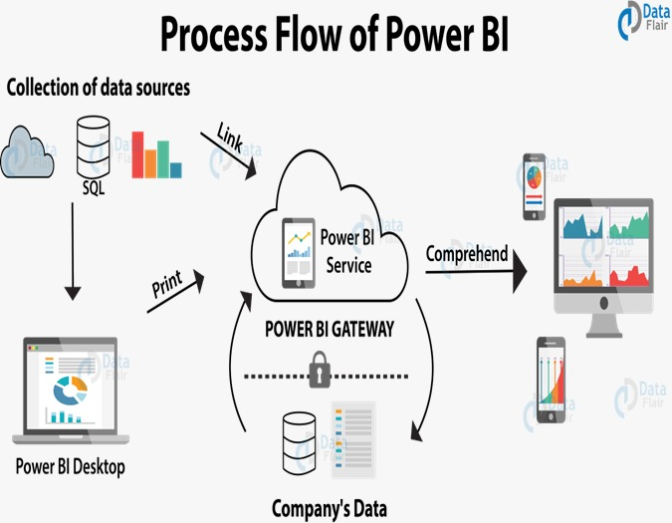
INTRODUCTION
Airplane analysis on PowerBI allows for in-depth insights into aircraft performance.
PowerBI enables visualizations of key aviation metrics for better decision-making.
The analysis includes data on flight routes, fuel consumption, maintenance schedules, and more.

Slide 4
DATA SET DESCRIPTION
1. Date: Date of the airplane crash.
2. Time: Time of the airplane crash.
3. Location: Location where the airplane crash occurred.
4. Operator: Operator or airline involved in the incident.
5. Flight #: Flight number associated with the incident.
6. Route: Planned route of the flight.
7. AC Type: Aircraft type involved in the crash.
8. Registration: Registration details of the aircraft.
9. cn/ln: Construction or serial number of the aircraft.
10. Aboard: Total number of individuals aboard the aircraft.
11. Aboard Passengers: Number of passengers aboard the aircraft.
12. Aboard Crew: Number of crew members aboard the aircraft.
13. Fatalities: Total fatalities in the incident.
14. Fatalities Passengers: Number of passenger fatalities.
15. Fatalities Crew: Number of crew member fatalities.
16. Ground: Casualties on the ground, if any.
17. Summary: Brief summary or description of the incident

Slide 5
PROJECT OBJECTIVES
1. Temporal Analysis:
- Explore temporal trends in airplane crashes over the years.
- Identify patterns in the frequency and severity of incidents.
2. Geospatial Analysis:
- Visualize crash locations on a map to identify hotspots.
- Analyse the distribution of incidents across different regions.
3. Operator Performance:
- Evaluate the safety records of different operators and airlines.
- Identify operators with higher incident rates.
4. Aircraft Analysis:
- Analyse the involvement of specific aircraft types in incidents.
- Examine the relationship between aircraft registration and crash occurrences.
5. Fatality Trends:
- Explore trends in passenger and crew fatalities.
- Investigate factors contributing to fatalities.
6. Route Analysis:
- Analyse incident patterns on specific flight routes.
- Identify routes with a higher likelihood of incidents.

Slide 6
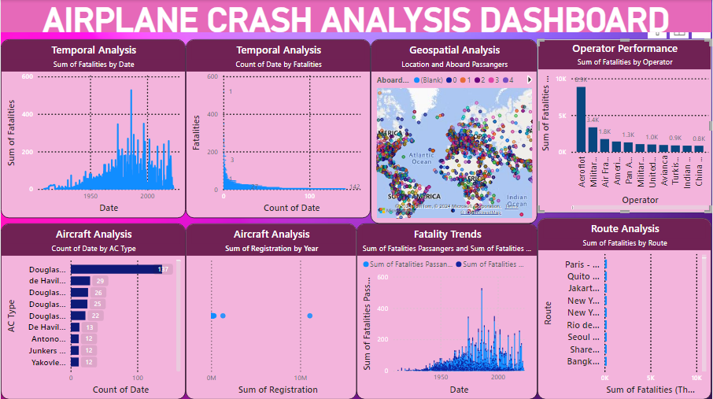

Slide 7

CONCLUSION
Power BI helps us look at airplane crash data in a clear and easy way. We can see what factors might have contributed to crashes, like weather or maintenance issues. This helps aviation experts and authorities make flying safer by understanding what went wrong and how to prevent it in the future.

Slide 8


